Slide 1

Artificial Intelligence in the Air Traffic Control System
Prepared by Stathis Malakis
IFATCA JCHMS Team

Slide 2
Presentation Details
Version 1.0
17/5/2024
Slides : 15

Slide 3
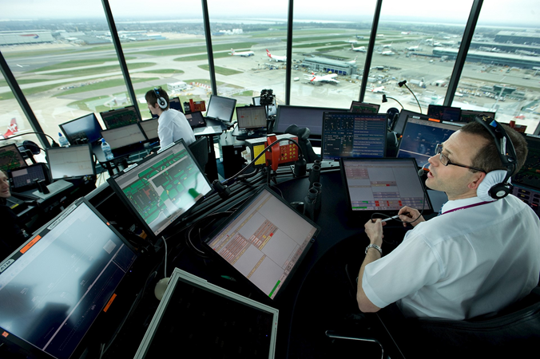

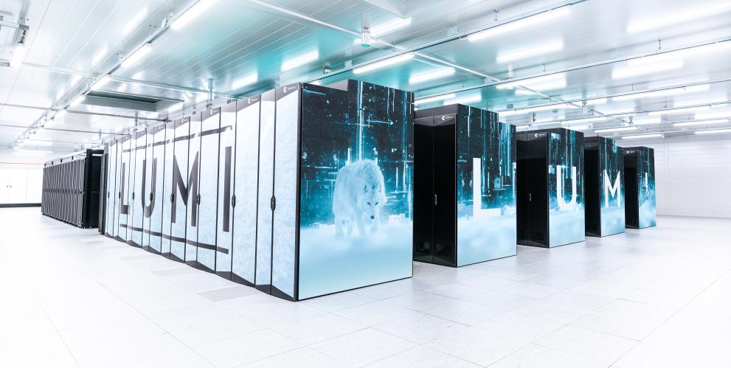

Origins : Artificial Intelligence in Safety Critical Domains
Growing momentum for introducing AI in safety critical domains (e.g. ATC) building upon:
Advances in capacity to collect and store massive amounts of data
Significant increases in computing power
Development of increasingly powerful algorithms and architectures

Slide 4

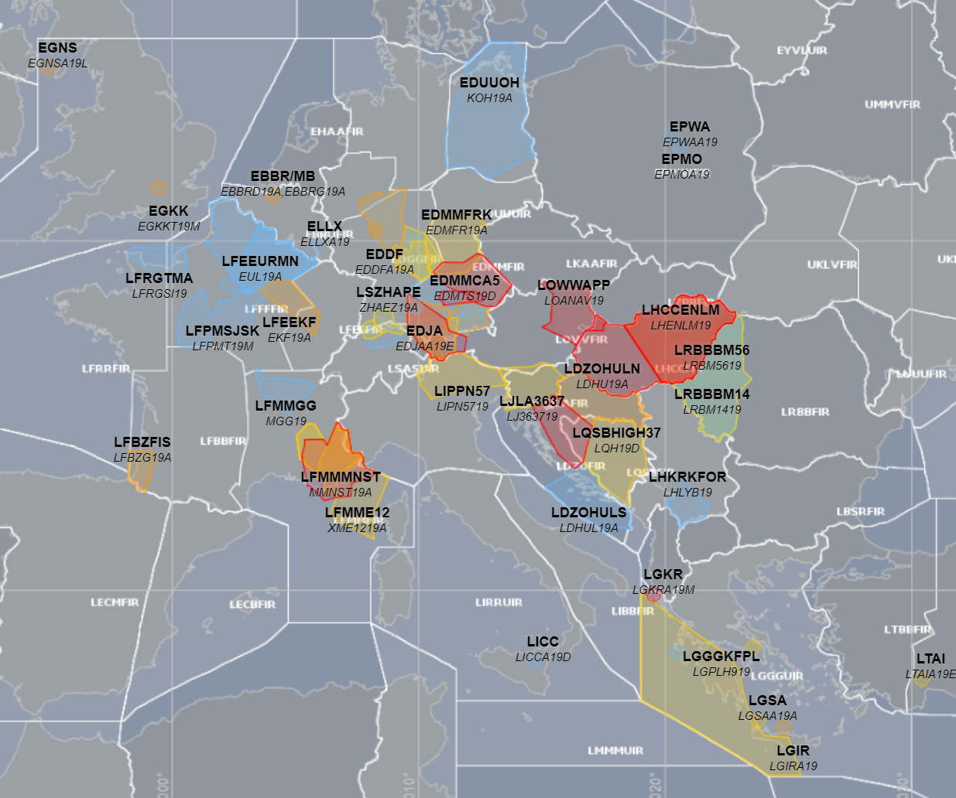
Motivation
Envisioned AI/ML - driven ATM environment with pressing needs for:
  Minimization of delays
  Accommodating a diverse array of autonomous aircraft
  Operating smoothly in adverse weather conditions
  Smoothing out 4D aircraft trajectories, and
  Minimizing environmental impact

Slide 5
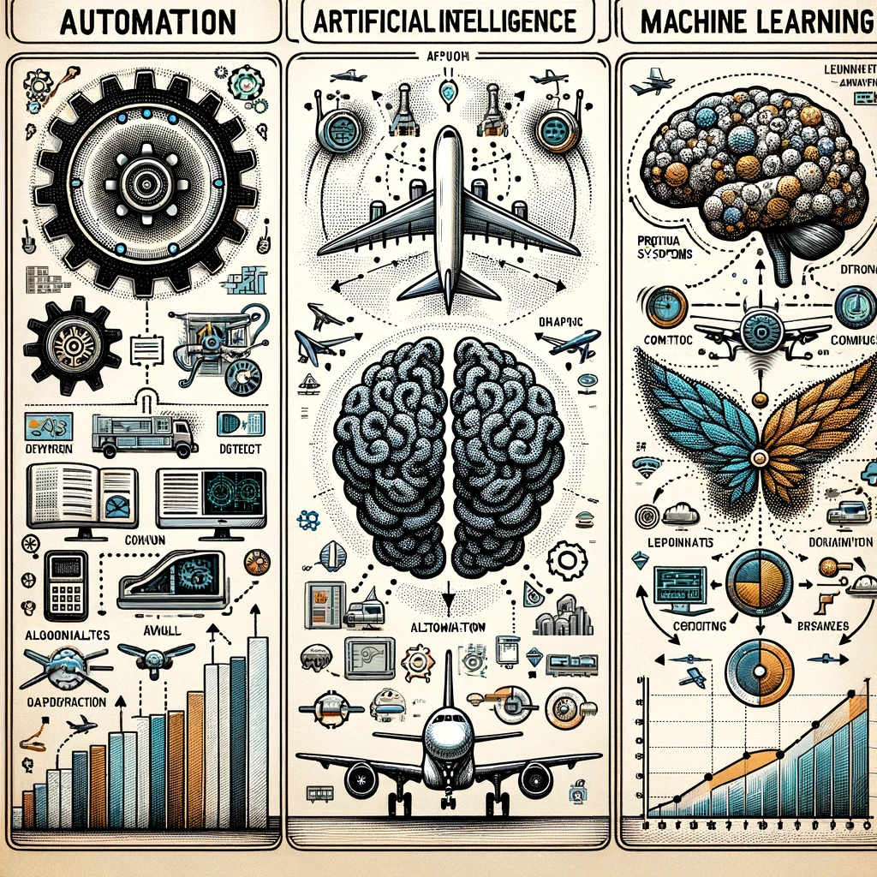
Automation, AI and ML
AI is the ability of a digital computer or computer-controlled robot to perform tasks commonly associated with intelligent beings.
ML can be defined as programming computers to optimize a performance criterion using example data or experience.

Slide 6
Fundamental Challenges Of Implementing AI
Fundamental Challenges Of Implementing AI

Slide 7
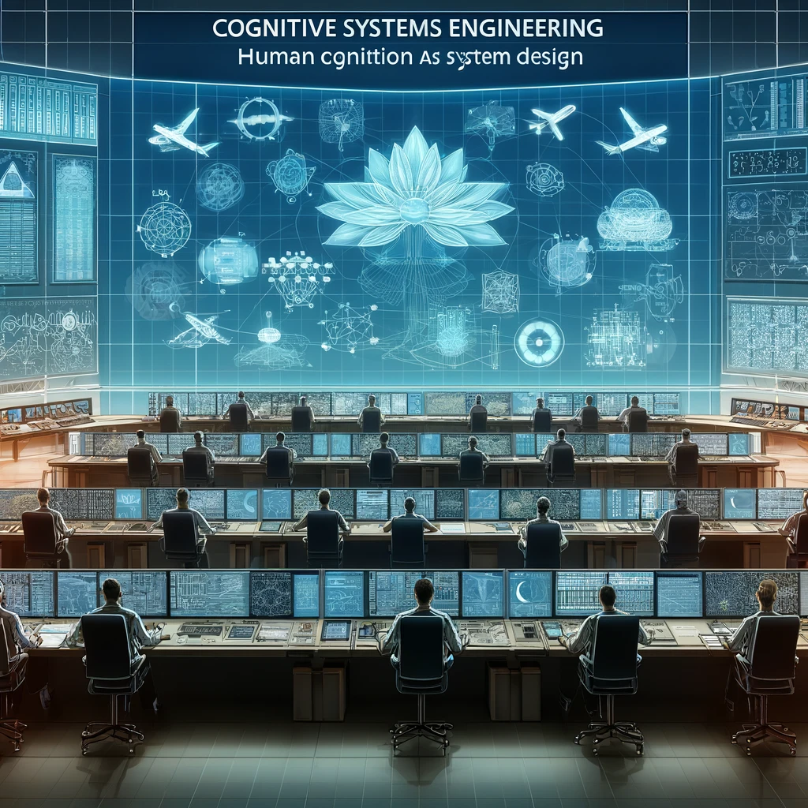
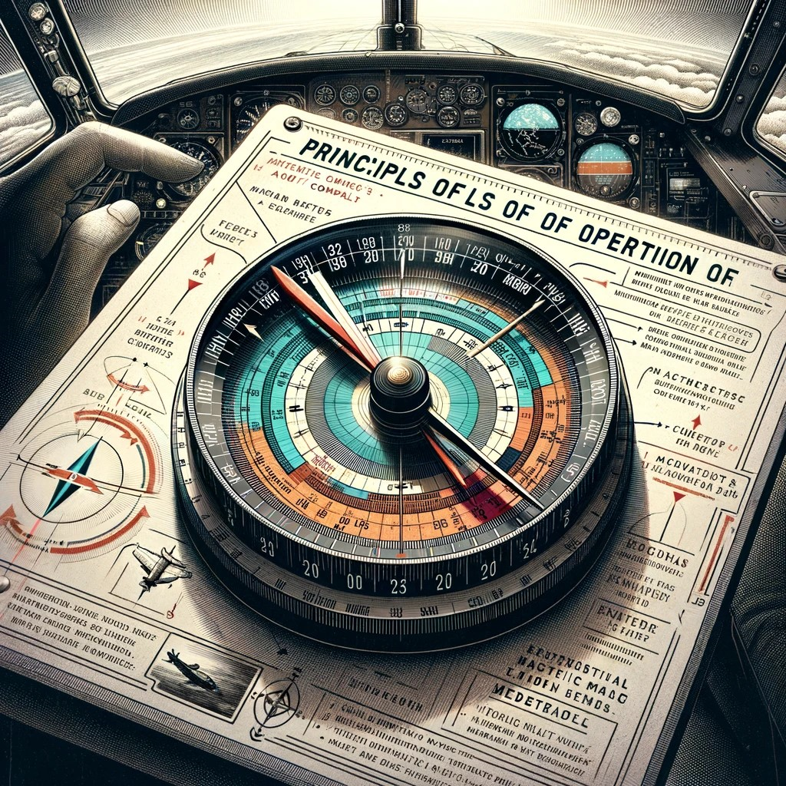
Cognitive Systems Engineering as Principle of Design

Slide 8
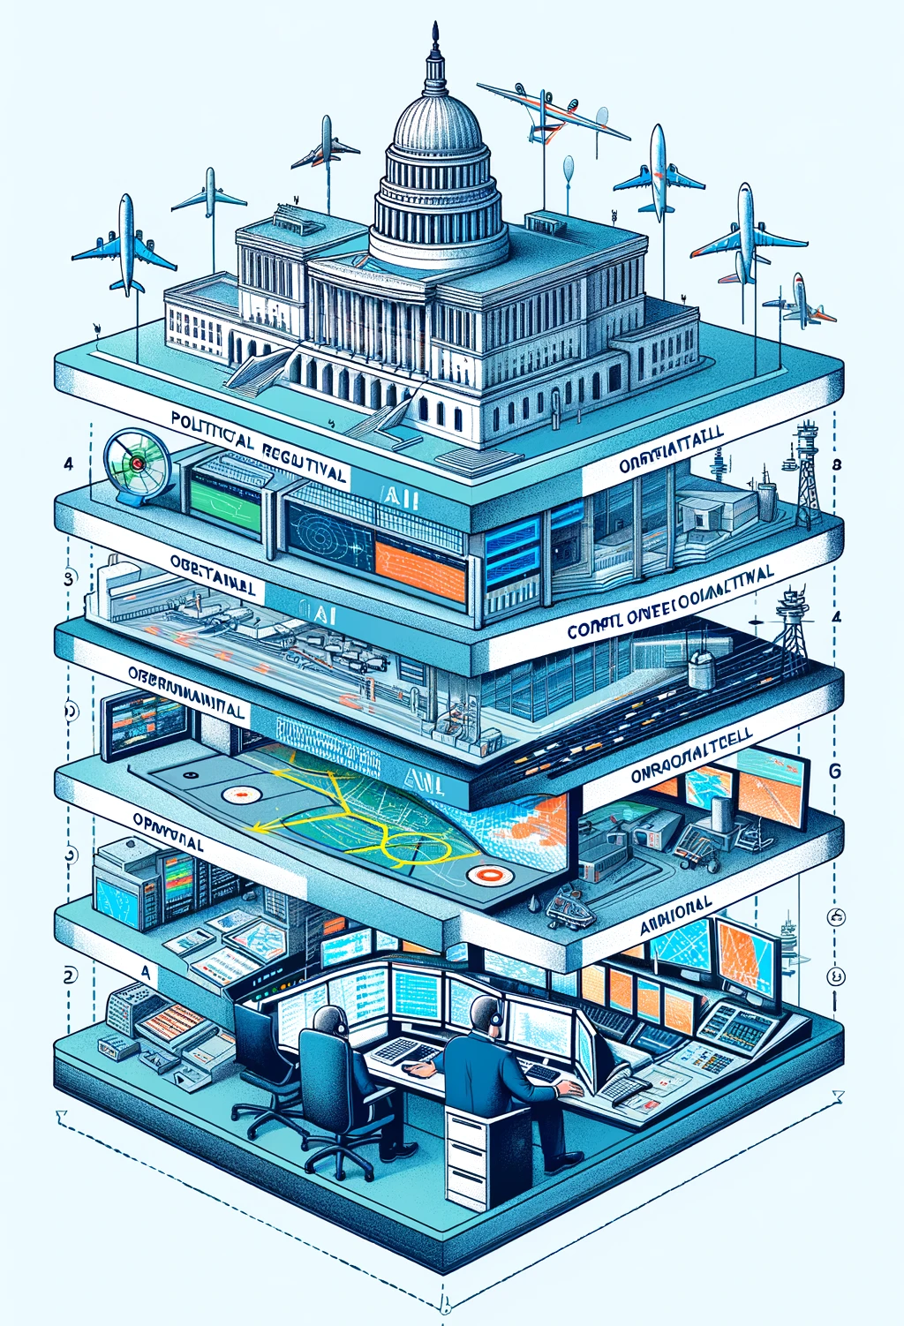
5 Levels of Analysis
Level – 1: Political / Regulatory
Level - 2: ANSP / Business
Level - 3 : Technical
Level - 4 : Operational
Level -5 : Air Traffic Controllers

Slide 9
5 Levels of Difficulties

Slide 10
Most Difficult
Keeping the ATCO ‘in the loop', situationally aware and able to intervene.
Disruption of established patterns in coordinated activity and resilience.
Increasing instances of automation (AI/ML) surprises.
Increased space for potential and new type of errors that cannot be easily foreseen.
Demands for new kind of knowledge and skills.
Demands for more threads to track that makes attention management difficult.
Demand for the development of new mental models, how the AI system works, how it fails, why it fails, and how to adapt.
ATCOs acceptance of their new roles and remits.
Synchronizing an increased number of micro-cultures of ATCOs’ communities which are
based on their local practices and local affordances.
De-Skilling of ATCOs.
ATCOs’ intervening during failures and contingencies, (Leftover strategies).
Vigilance / boredom tradeoffs.
Managing of social aspects (e.g., relocation and mobility of ATCOs).
Resistance from ATCOs’ who could legitimately fear for their jobs.

Slide 11
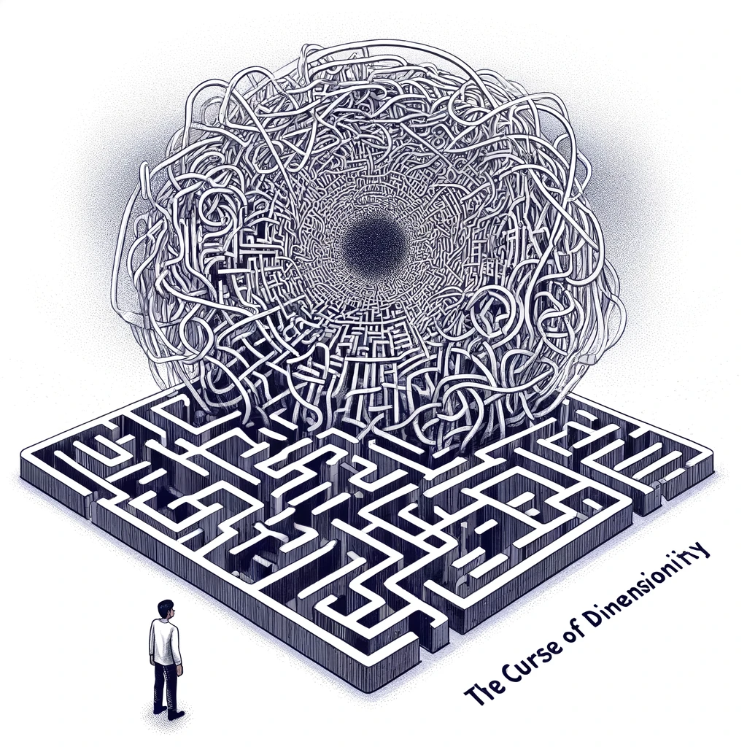
The major limitations of AI

Slide 12

The major limitations of AI
AI and Just Culture
Without AI/ML it is difficult but possible to draw the red line
The introduction of AI/ML in essence clouds the drawing of red line.
We need to redefine just culture in the era of digitalization.
Red Line
Willful Violation
Honest Mistake

Slide 13
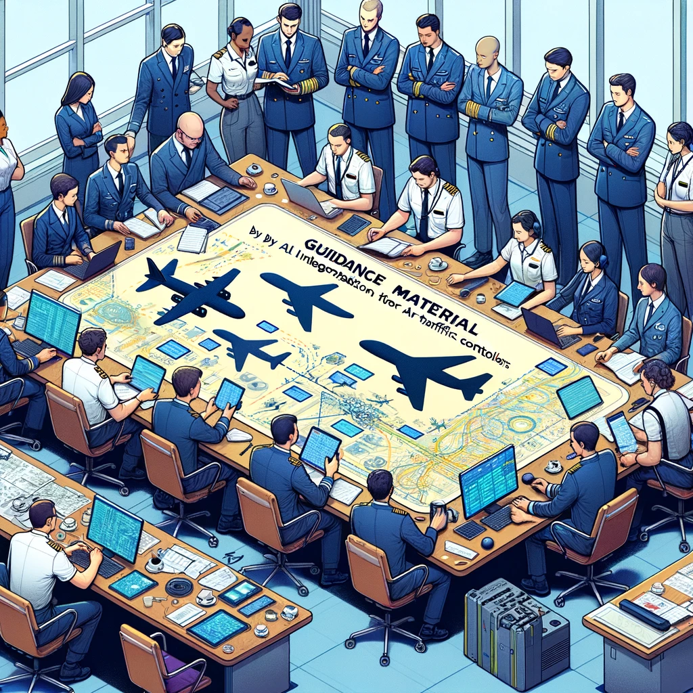
Guidance Material
Written by
Air Traffic Controllers
for
Air Traffic Controllers
We want
technology that serves ATCOs
and not
ATCOs that serve technology

Slide 14
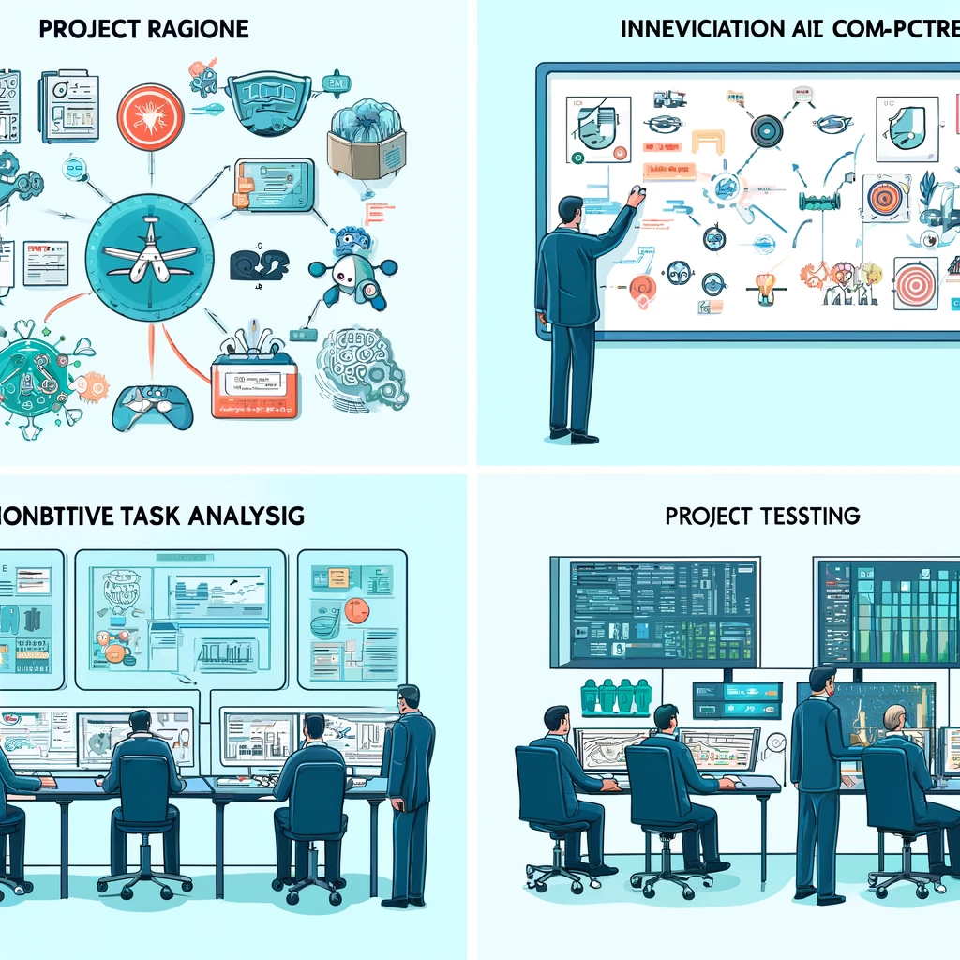
A Four-step Process
Project Rationale
Identification of ATC Competencies
Cognitive Task Analysis
Project Testing

Slide 15
Questions

